Slide 1

WEEK 15
CESAR A. PASCAL VASQUEZ

Slide 2
This week, I focused on learning more about the Unitree R1 and comparing its capabilities with the previously used G1. I also worked on developing a control policy that would allow the robot to stand steadily and begin moving.

Slide 3
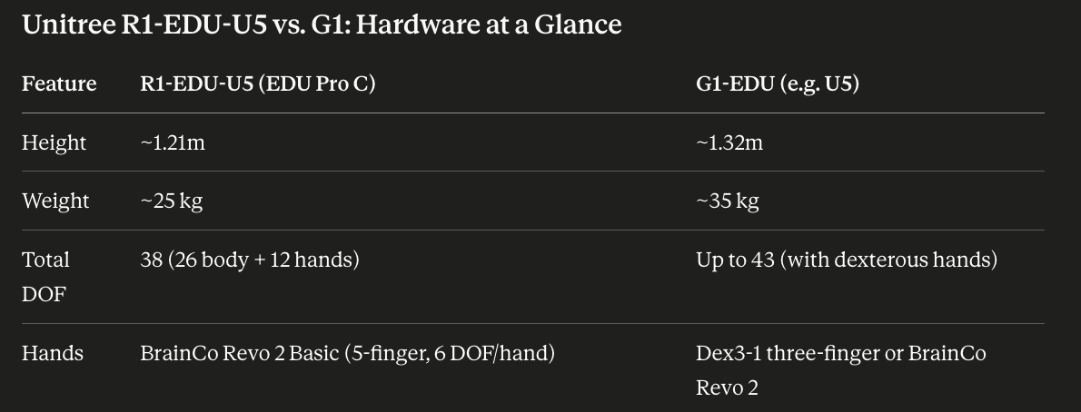
The G1 and R1 are similar in several aspects, but they have important differences in their hardware design and capabilities.

Slide 4
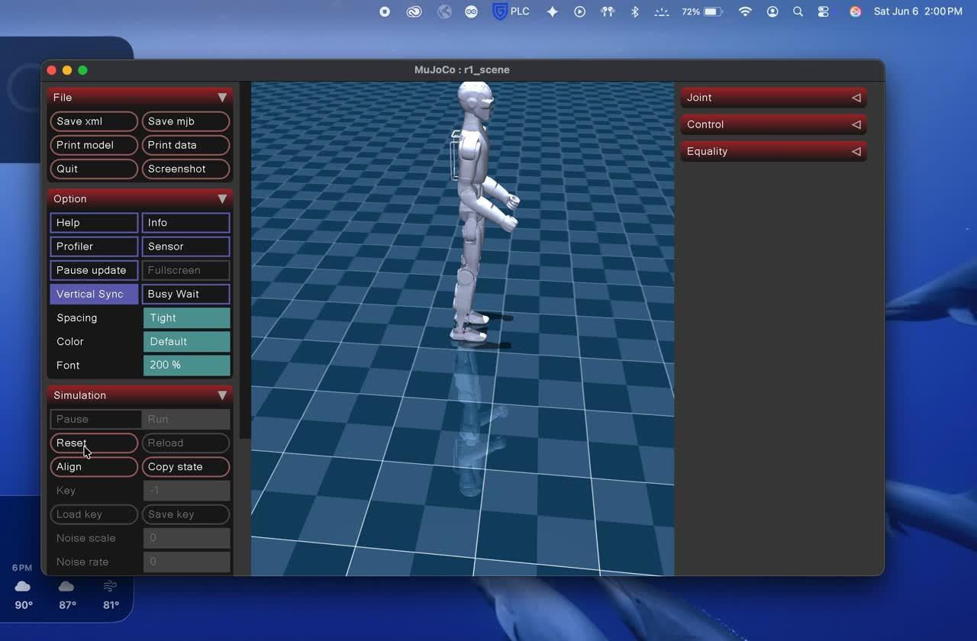
In terms of training, the main differences are the number of joints, degrees of freedom, and range of motion. Although the G1 and R1 have some similarities, their joint configurations and movement capabilities are different. However, the fundamental training principles remain the same for both robots. Here is the R1 being deployed in mujoco.

Slide 5
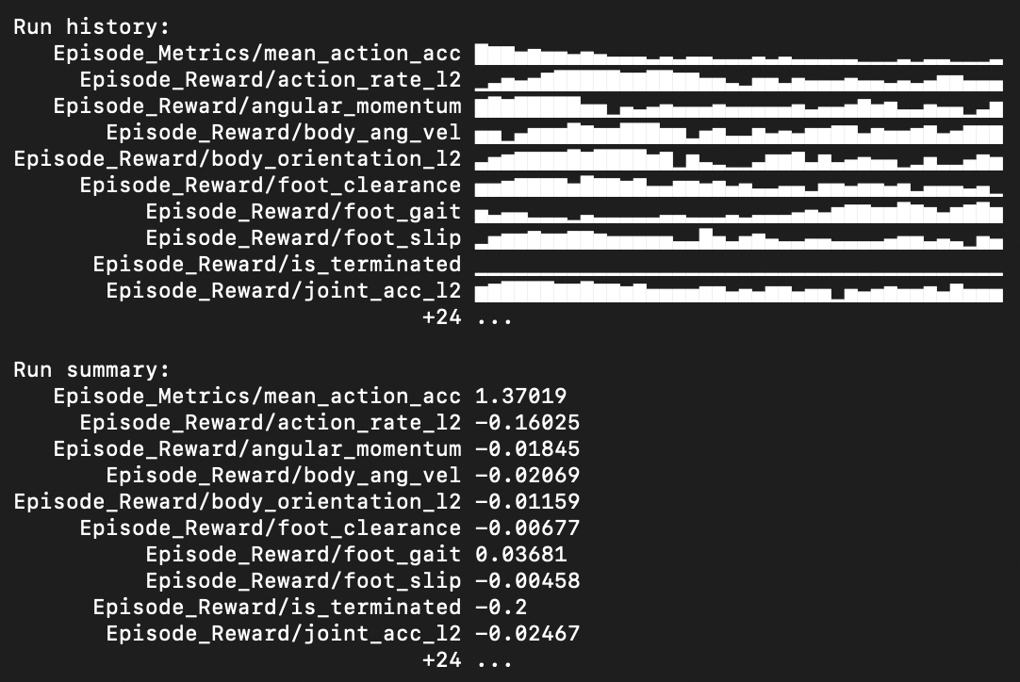
This was the training process. Due to CPU limitations, I could use only one environment. Despite this constraint, the policy was able to learn how to stand and move slightly. Using multiple parallel environments would likely improve training efficiency, stability, and the overall performance of the policy significantly.

Slide 6
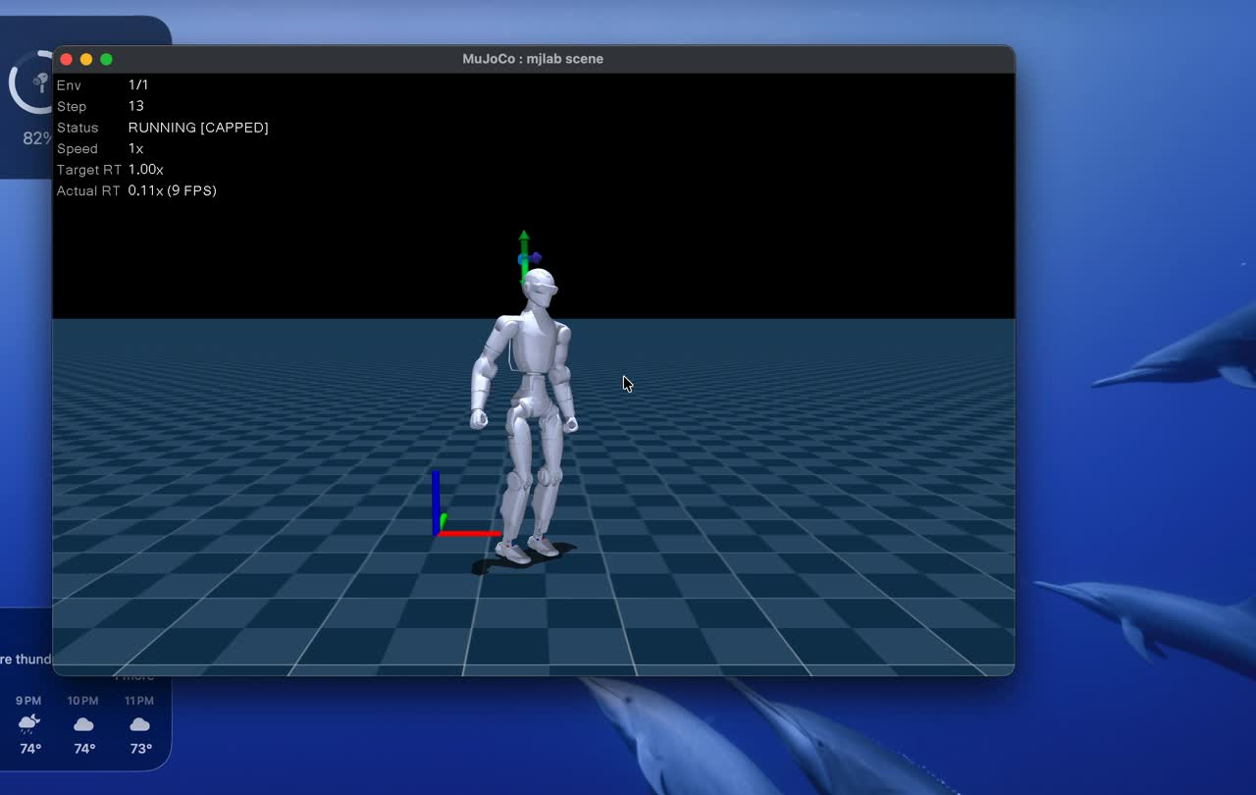
The training results were promising. After approximately 5,000 iterations, which took around one hour, the robot was already able to stand successfully.

Slide 7
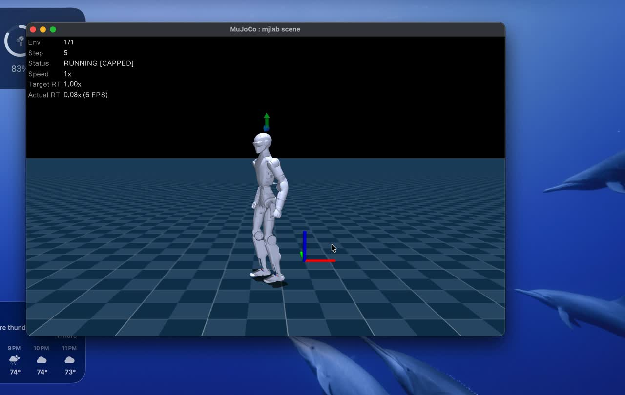
After doubling the number of iterations, a significant improvement in the robot’s movement could be observed, especially considering that the training was still performed using only a single environment.

Slide 8
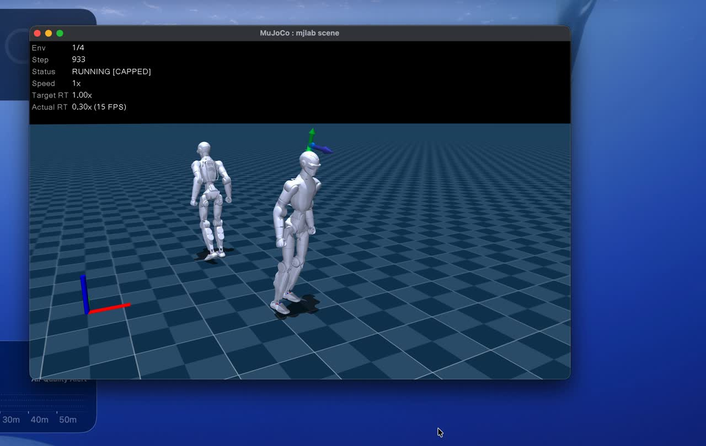
For 4 envs and 10000 iterations

Slide 9
The next steps are to improve the policy through more extensive training, preferably using a GPU to increase computational power and achieve better results. After developing a more stable walking policy, the goal will be to train the robot to perform more advanced tasks beyond basic locomotion.

Slide 10
Reference
  Todorov, E., Erez, T., & Tassa, Y. (2012). MuJoCo: A physics engine for model-based control. IEEE/RSJ International Conference on Intelligent Robots and Systems (IROS), 5026–5033.
  Unitree Robotics. Unitree RL Mjlab & R1 Robot Deployment Configuration Framework. Retrieved from https://github.com/unitreerobotics/unitree_rl_mjlab/tree/main/deploy/robots/r1

